Slide 1


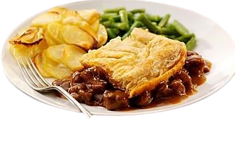
SMS Food
Ordering System

Slide 2
By:
Maliha Akhtar | 2021-GCUF-058598
Samreen Akhter | 2021-GCUF-058630
Sana Kouser | 2021-GCUF-058595
Supervised By:
Prof. Yasir Arfat

Slide 3


Introduction:
Overview:
This project aims to develop a web-based platform that allows users to browse restaurant
menus, place orders, and make payments online, enhancing convenience for customers
and operational efficiency for restaurants.​
Objectives:
Simplify the food ordering process for customers.​
Provide restaurants with an efficient system to manage orders and deliveries.​
Offer multiple payment options to users.​

Slide 4

Problem Statement:
Restaurants often face inefficiencies in managing orders and payments, leading to delays and customer dissatisfaction.
Existing solutions lack customization for small to medium-sized businesses.
This project aims to fill the gap by providing a scalable, easy-to-use, and customizable solution tailored to restaurant needs.

Slide 5
Functions:
User-Side Functions:
User Registration & Login – Secure authentication and user account creation.
Menu Browsing – Browse categorized food items with images, prices, and descriptions.
Search & Filter – Quickly find dishes using smart filters (e.g., veg/non-veg, category, price).
Add to Cart – Select and store items before checkout.
Online Order Placement – Choose delivery/pickup and confirm orders.
Secure Payment Integration – Pay via debit/credit cards or wallets.
Order Tracking – Real-time updates on order status (e.g., preparing, dispatched).
Order History – View and repeat previous orders.
Smart Recommendations – Get dish suggestions based on past orders or popularity.
One-Click Reorder – Instantly repeat your last meal.
Custom Combo Builder – Create personalized combos with special discounts.
Scheduled Orders – Place orders in advance for a selected time slot.
Post-Delivery Feedback – Rate your order experience after delivery.
Download Bill (PDF) – Get a digital receipt after every order.
Dark Mode Toggle – Switch to dark theme for better accessibility.

Slide 6
Functions:
Admin-Side Functions:
Admin Login – Secure access for restaurant managers/staff.
Menu Management – Add, edit, delete food items and categories.
Order Management – View all incoming orders and update their statuses.
User Management – Monitor customer activity and manage users.
Daily Order Log – View basic reports on sales/orders.
Real-Time Order Alerts – Sound/popup notifications when new orders arrive.
Low Stock Warnings – Alerts when item stock drops below minimum level.
Feedback Viewer – Read customer reviews and ratings for quality improvement.

Slide 7
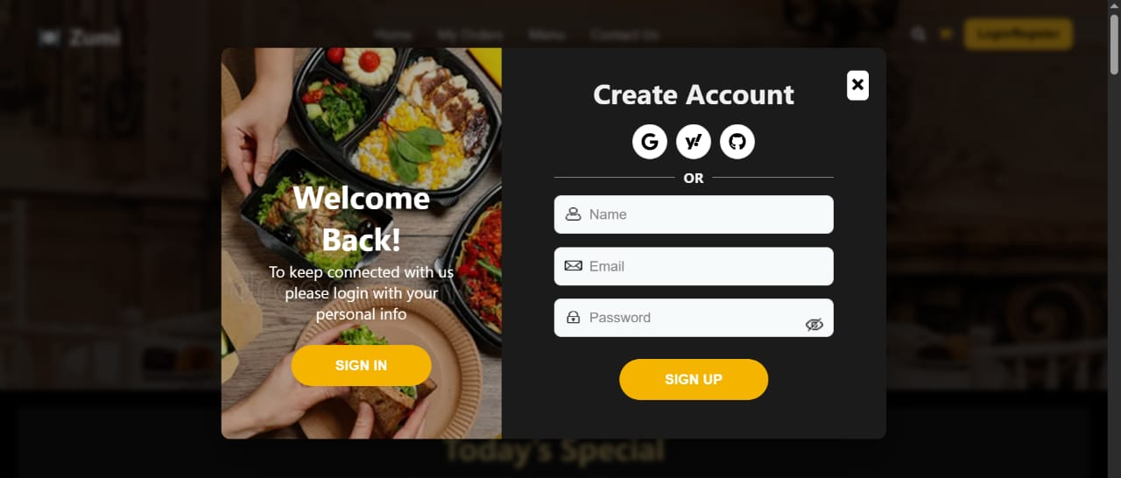
Login / Signup Page:

Slide 8
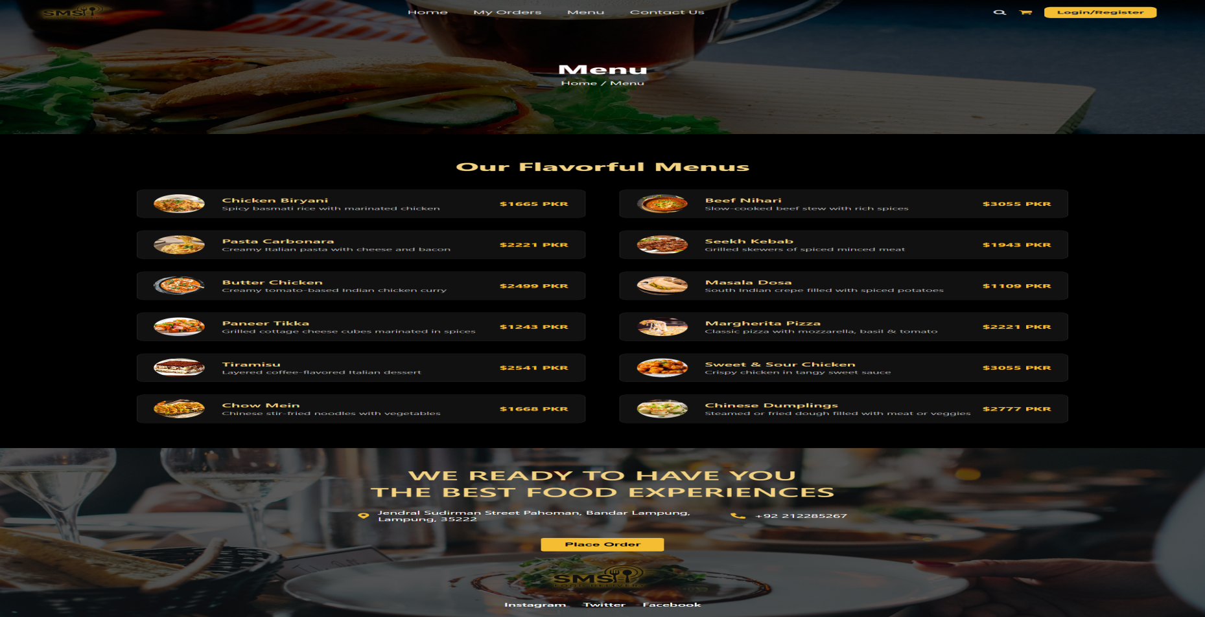
Menu Page:

Slide 9
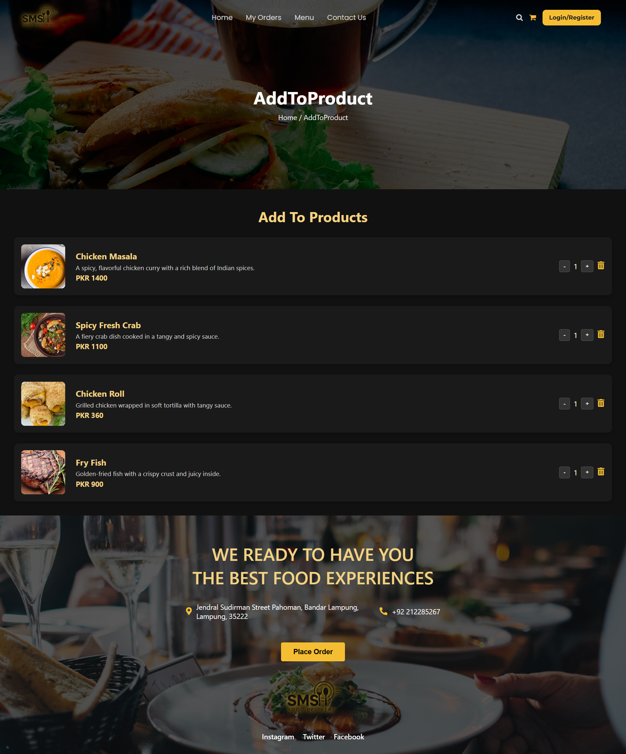
Cart Page:

Slide 10
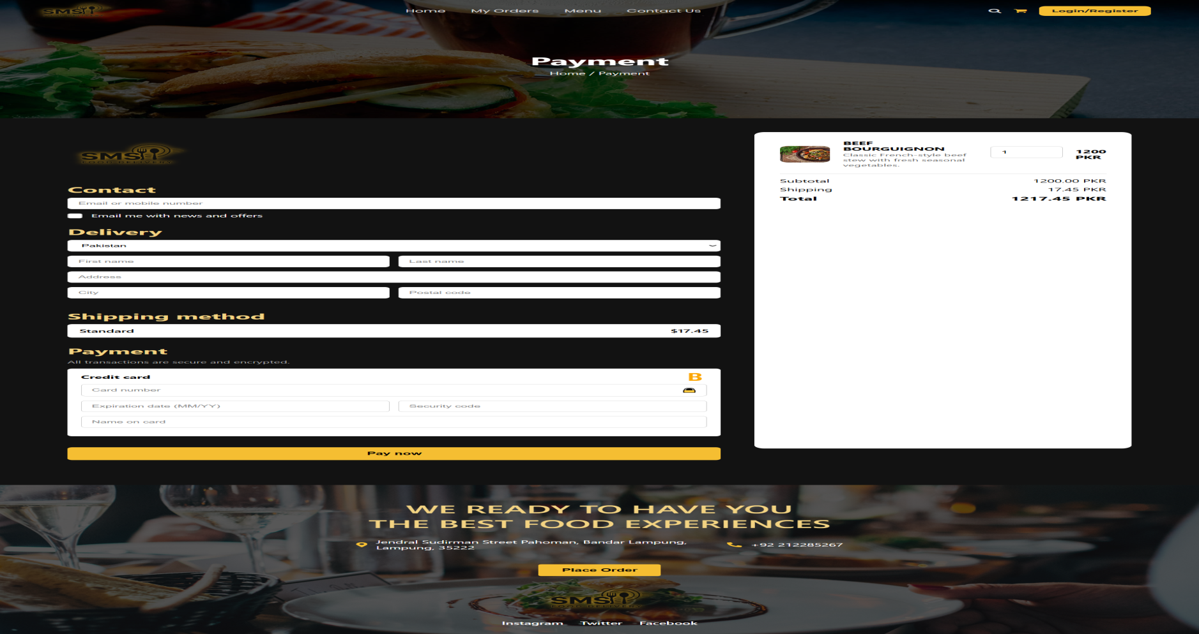
Checkout Page:

Slide 11
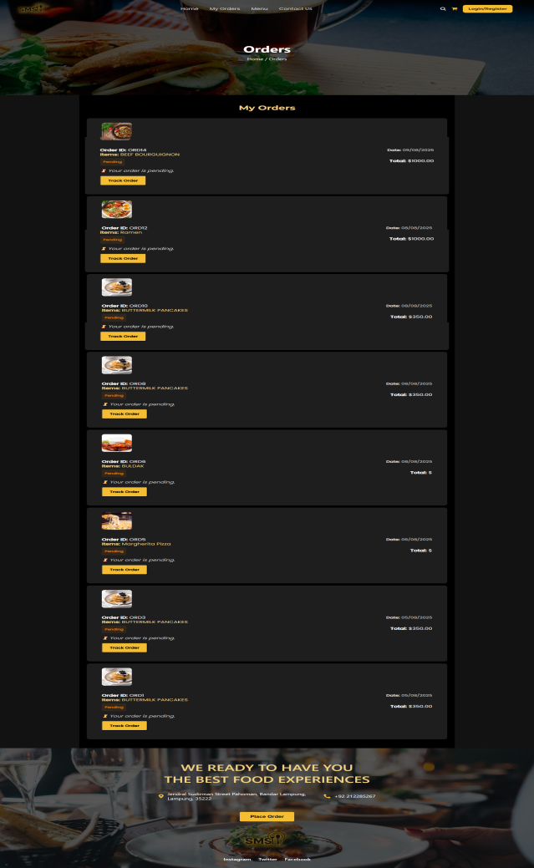
My Orders Page:

Slide 12
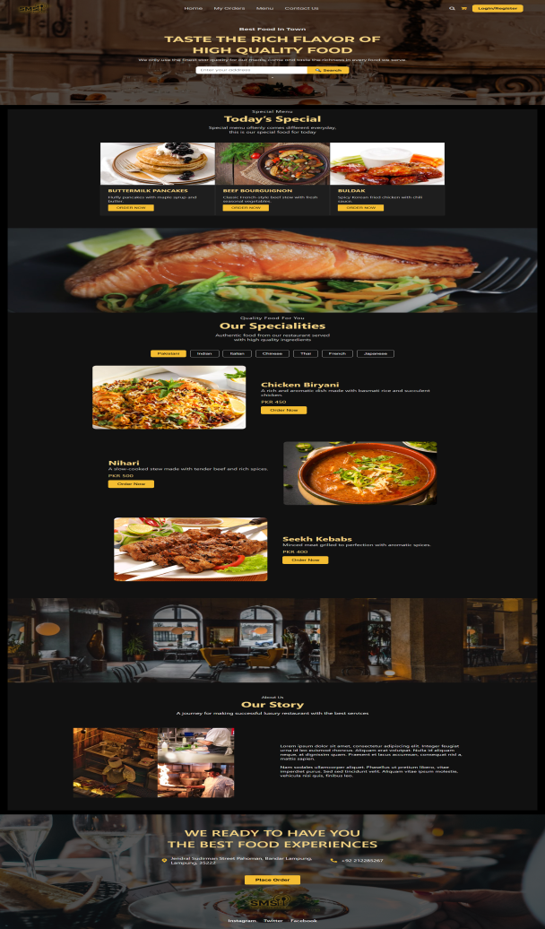
Admin Dashboard Home:

Slide 13
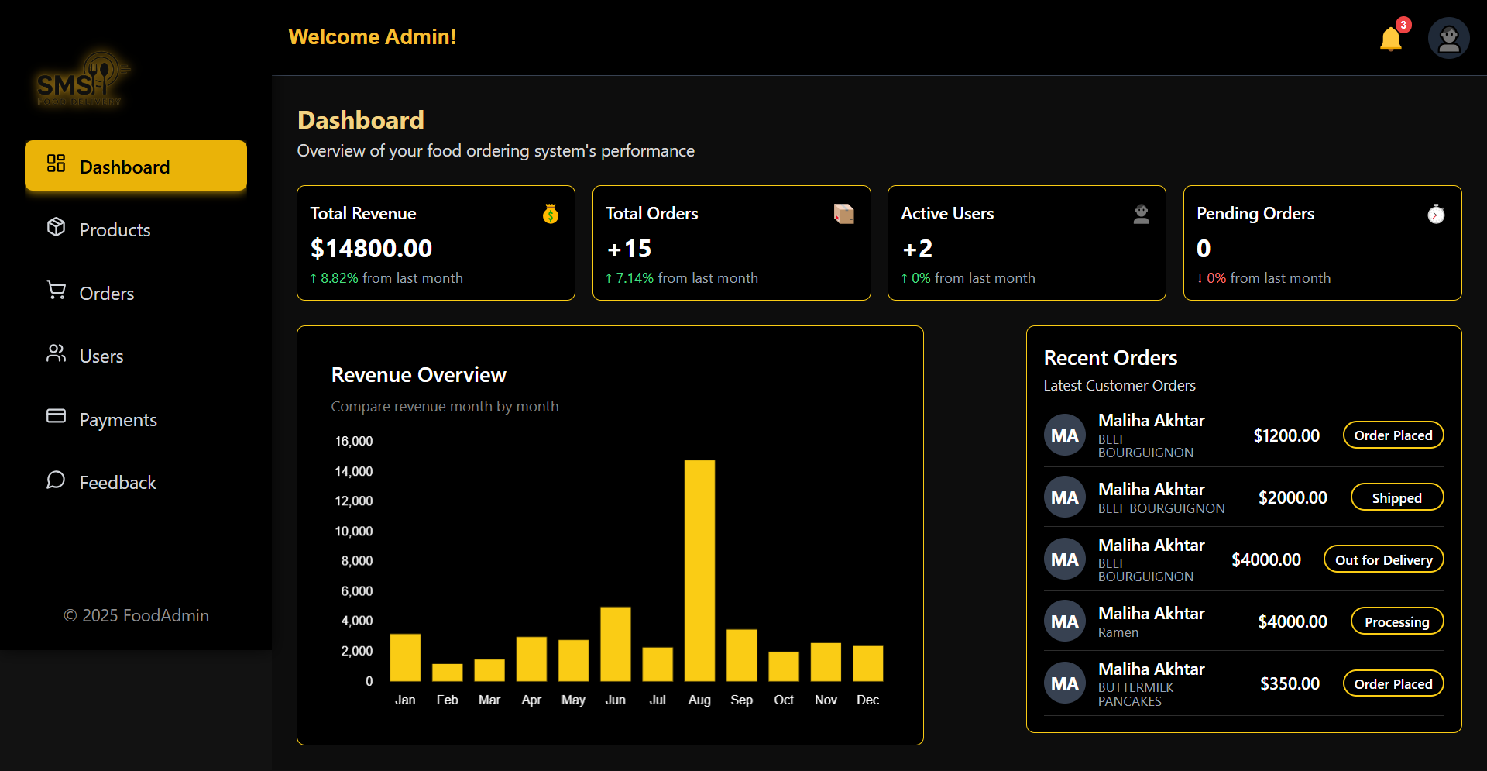
Admin Dashboard :

Slide 14
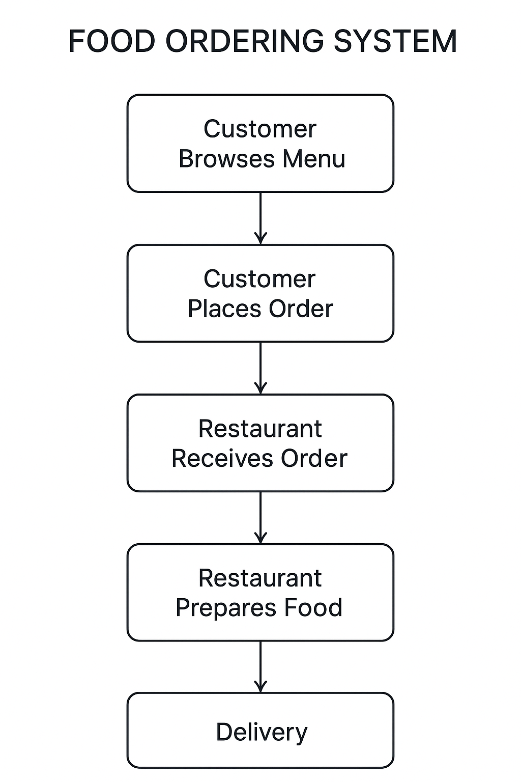
Website Workflow Diagram:

Slide 15
Technologies:
Frontend Technologies:
HTML5 – Structure and layout of web pages
CSS3 – Styling for UI, responsive design
JavaScript (Vanilla JS) – Interactive elements, client-side logic
Figma – Designing wireframes and user interfaces.
Backend Technologies:
Node.js – Server-side JavaScript runtime environment
Express.js – Lightweight and fast web application framework for Node.js
Database:
MySQL – Relational database for storing users, orders, menu, feedback, etc.

Slide 16
Technologies:
Additional Tools / Libraries:
Nodemon – Automatically restarts server during development
Body-Parser – Middleware to handle incoming request bodies
HTML-PDF (optional) – For generating downloadable order invoices
Socket.io (optional) – Real-time updates and notifications (e.g., order status)
Security & Optimization:
HTTPS (SSL) – Secure data transmission (recommended)
Express Validator – To validate and sanitize user inputs
bcrypt.js – For secure password hashing (if login system requires it)
Justification:
This technology stack is chosen for being lightweight, scalable, and beginner-friendly. It supports rapid development and provides strong community support — ideal for modern full-stack web applications.

Slide 17
Old website vs new website:
Aspect | Old Websites | New / Modern Websites
Design & UI | Static, simple layouts, non-responsive | Modern, responsive, mobile-friendly, interactive UI
Device Compatibility | Desktop-only | Works on mobiles, tablets, and desktops
Ordering Process | Manual or basic form | Automated cart
Menu Display | Text - only menu | Images, categories, filters, and search
Payment Options | Cash on delivery only | Cards, wallets, online banking
Admin Control | No admin panel | Dashboard with orders,

Slide 18
References:
Tools & frameworks Documentation:
React.js Documentation : https://reactjs.org/docs/getting-started.html
Node.js Documentation https://nodejs.org/en/docs/
Express.js Documentation : https://expressjs.com/en/starter/installing.html
MySQL Official Documentation https://dev.mysql.com/doc/
Figma Design Tool: https://www.figma.com/resources/learn-design
React Router Documentationhttps://reactrouter.com/en/main/start/tutorial
JWT (JSON Web Tokens) Authentication Guide https://jwt.io/introduction

Slide 19
References:
Academic & Technical References:
Acharya, K. (2024, May 2). Online Food Order System. SSRN. https://ssrn.com/abstract=4814732
Ahmad, S., & Khan, M. (2022). A study on online food ordering systems and their impact on the restaurant industry. International Journal of Computer Applications, 184(34), 10–15. https://doi.org/10.5120/ijca2022922644
Kaur, P., & Singh, H. (2021). Development of a web-based
•food ordering system. International Research Journal of Engineering and Technology (IRJET), 8(6), 4521–4526.
Tandon, A., & Sharma, R. (2020). Design and implementation of an online food delivery system. Journal of Emerging Technologies and Innovative Research, 7(8), 154–160.

Slide 20
References:
Online Sources & Articles:
Statista. (2024). Revenue in the online food delivery market worldwide. https://www.statista.com/outlook/dmo/eservices/online-food-delivery/worldwide
Food Fusion. (2023). Food ordering user interface design inspiration. https://www.foodfusion.com/
W3Schools. (2025). React tutorial. https://www.w3schools.com/react/
GeeksforGeeks. (2024). How to build an online food ordering system using MERN stack. https://www.geeksforgeeks.org/
Medium. (2023). Best practices for developing an online food ordering app. https://medium.com/

Slide 21
Conclusion & Future Work
The project successfully provides a complete online food ordering experience. Future enhancements include real-time delivery tracking and mobile app integration

Slide 22


